Slide 1

Digital portfolio
1) STUDENT NAME - DHARSHINI.S
2) REGISTER NO AND NMID - 34624u09021 AND astvu34624319
3) DEPARTMENT - BACHOLER OF COMPUTER APPLILCATION
4) COLLEGE / UNIVERSITY - MMES WOMENS ARTS AND SCIENCE COLLEGE / THIRUVALLUVAR UNIVERSITY
.

Slide 2
PROJECT TITLE
* ... Design and implementation of a portfolio website

Slide 3
AGENDA
1) Problem Statement
2) Project Overview
3) End Users
4) Tools and Technologies
5) Portfolio design and Layout
6) Features and Functionality
7) Results and Screenshots
8) Conclusion
9) Github Link

Slide 4

1) PROBLEM STATEMENT
* In the digit era , individuals often struggle to present their skills , acending a achivements , and projects in an organized and professional manner.
* Traditional resumes and paper-based portfolios have limitations in terms of accessibility , interactivity , and reach .
* There ia s need for a responsive and user-friendly online portfolio website that can effectivly showcase an individual’s profile , skills , and projects to potential employers , academic institutions , and collaborators .

Slide 5
2) PROJECT OVERVIEW
* The portfolio project is a web-based application designed to display personal and professional information in a structured and visually appealing manner .
* IT provides sections like About Me , Skills , Projects , Resume , and Contact .
* The main objective is to create a strong online Presence that helps on career growth , professional networking , and job opportunities .

Slide 6
3) END USER
1) Students / Freshers – To showcase academic projects and skills.
2) Professionals – To highlight work experience, achievements, and certifications.
3) Freelancers – To attract clients by displaying previous work.
4) Recruiters / Employers – To evaluate the candidate’s portfolio before hiring.

Slide 7
4)TOOLS AND TECHNOLOGIES
Explanation : The software , coind language , and platforms used to create the project .
EXAMPLE :
1) HTML5 - Structured of the website
2) CSS3 - Styling ( colouring layout , animations , transitions)
3) Javascript - Functionality(menu toggle , animations)
4) Vs code - code editor for development
5) Git & Github - store and host the project online
6)Hosting: GitHub Pages, Netlify, or Vercel

Slide 8
5) PORTFOLIO AND DESIGNS
1) Homepage: Hi , l’m DHARSHINI.web developer.”(with animation in the background )
2) About Section: short bio , profile picture , and career goal
3) Skills Section: A progress bar showing knowledge of HTML,CSS,JS
4) Projects Section: cards or boxes with screenshots and links to live projects
5) Contact Section:Email :adithisivakumar25@gmail.com and a form to send message
Design focuses on :
✅ User-friendly navigation
✅ Responsive layout (mobile & desktop)
✅ Professional but creative theme

Slide 9
6) FEATURES AND FUNCTIONALITY
... Explanation : What the portfolio can do
EXAMPLE :
1) Responsive - works on mobile , tables and laptop
2) Navigation bar - smooth scrolling between sections
3) Contact form - Lets users send messages
4)Animation - Buttons glow on hover , text fades in/out

Slide 10
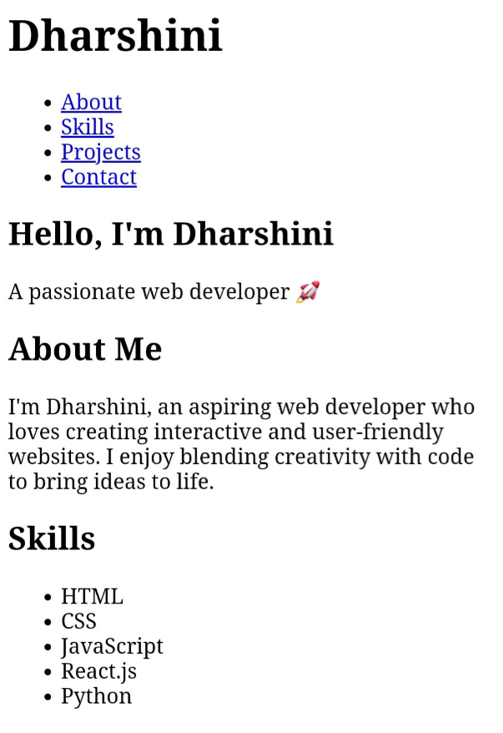
7) results and screenshorts
Explanation : What you after building the portfolio and how it looks .
EXAMPLE : Result : “The portfolio successfully display me skills , projexts , and contact information in an attractive way” .
*** result of screenshot***

Slide 11
8) CONCLUSION
* The portfolio website serves as a digital identity that helps in professional growth, career opportunities, and client engagement.
* It bridges the gap between a traditional resume and an interactive professional profile.
* This project demonstrates technical skills, creativity, and the ability to present information effectively.

Slide 12
9) GITHUB LINK
Explanation : Alink to your project respository on Gitghub so others can view .
EXAMPLE :
... Github Respository - portfoliio WEBSITE
* Dharshini/ at main · adithisivakumar25-dotcom/Dharshini https://share.google/XPRf0s1XR9S4YaQcu

Slide 13

“ THANKING FOR YOUR ATTENTION ”
Subtitle
Subtitle
Subtitle
Subtitle

